Slide 1




Module Name- Arrays & Linked Lists
Topic Name: Performance of Lists
EditEdit MasterMaster texttext stylesstyles

Slide 2

Today’s Agenda
List iterators
Introduction to Performance Management
Performance Measurement

Slide 3
Today’s Agenda
Physical Representation
Physical Representation- ArrayLists
Physical Representation- LinkedLists
Industry Demonstration

Slide 4
List Iterators
Let’s introduce you to an interesting feature called iterators which comes with lists.
Iterators – as the name suggests – are helper objects useful in iterating through container objects like lists.
Iterating through a list is nothing new to us. We have been doing this since the beginning of this section using various types of loops.
Let’s look at how the same can be done using iterators.

Slide 5
List Iterators
Let’s iterate through our studentList using an iterator now:
import java.util.*; //imports java.util.ListIterator
public class WithListIterator1 {
public static void main(String[] args) {
List<Student> studentList1 = new ArrayList<Student>();
Student s1 = new Student("Sujit",1);
Student s2 = new Student("Siddharth",2);
Student s3 = new Student("Karanpreet",3);
studentList1.add(s1);
studentList1.add(s2);
studentList1.add(s3);

Slide 6
List Iterators
iterateFwd(studentList1);
}
//The name of printStudentList is changed to iterateFwd
private static void iterateFwd(List<Student> students) {
//instantiation of ListIterator
ListIterator<Student> it = students.listIterator();
System.out.println("Printing student list...");
while(it.hasNext()) { //while used instead of for
System.out.println(it.next().getDetails()); }
}
}

Slide 7
List Iterators
The highlighted part of the code is our key function iterateFwd :
At first, we instantiate the list iterator and obtain it from the studentList passed to the function as input parameter.
The iteration is done with the help of a while loop which runs on the true condition of hasNext method of iterator which returns true if there is a next element in the iterator.

Slide 8
List Iterators
When there is a next element in the iterator, the execution enters the while loop and the next element in the iterator is called( using next method of iterators) and its details are printed.
Thus, the final order of printed elements is same as that obtained using the printStudentList method.
Well, if it does exactly the same thing as the printStudentList method, then why do we use them at all???

Slide 9

List Iterators
Well, the reason is that printing elements just like the printStudentList function is just one of the things we can do with this iterators; they have many more applications.
But before we move on to these applications, let’s clear our basics about the terms Iterator and List Iterator. These two terms are used interchangeably in this presentation but they have different meanings:

Slide 10

List Iterators
Iterator is an interface in Java, which is used to iterate over a collection of objects.
You can think of an ‘iterator’ as a cursor to an element in a collection.
Also, you can use the ‘iterator’ (or the cursor) to move to the next element in the collection.
ID: 674085859

Slide 11

List Iterators
ListIterator is a subinterface of the Iterator interface, which is used to iterate over a list.
It has a lot more features than the Iterator interface. These features are given below:
It is used to traverse a list in any direction, i.e. forward or backward, very easily.

Slide 12
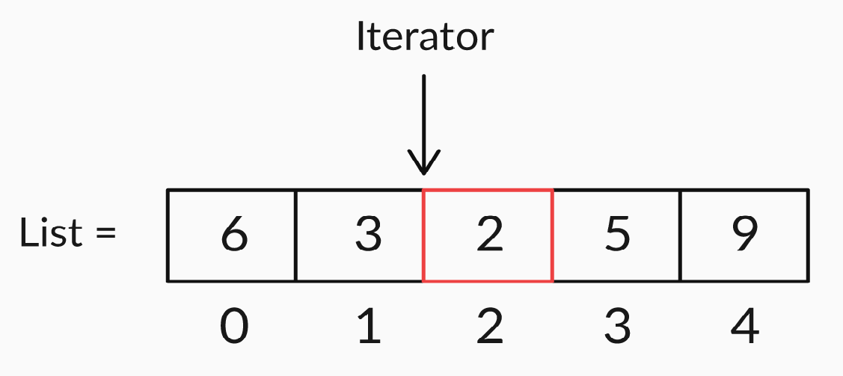
List Iterators
It doesn’t point to any current element; its cursor position always lies between the previous and next elements (refer figure given below).
It has methods to find out if there exists a next or previous element and to find the value of this next or previous element, as well as its indices.

Slide 13
List Iterators
Now, let’s look at another type of traversal — iterating backward on a list. Both the iterateFwd and iterateBkwd functions are given below for your better understanding:
private static void iterateFwd(List<Student> students) {
ListIterator<Student> it = students.listIterator();
System.out.println("Printing student list...");
while(it.hasNext()) {
System.out.println(it.next().getDetails()); }}
private static void iterateBkwd(List<Student> students) {
ListIterator<Student> it = students.listIterator(students.size());
System.out.println("Printing student list...");
while(it.hasPrevious()) {
System.out.println(it.previous().getDetails()); }}

Slide 14

List Iterators
There are three key changes in the iterateBkwd function:
ListIterator<Student> it = students.listIterator(students.size());
Using the argument student.size() instead of the default constructor means that the after the initialization, the iterator points beyond the last element and we can travel backward from there.

Slide 15

List Iterators
There are three key changes in the iterateBkwd function:
while(it.hasPrevious())
Since we are starting from the last element, the new loop condition will be the boolean check if the iterator has a previous element.

Slide 16
List Iterators
There are three key changes in the iterateBkwd function:
System.out.println(it.previous().getDetails());
When the previous element exists, we go back to that previous element and print its detailed. Thus, one by one, the list is printed in reverse order.
Z Y X W V U T S R Q P O N M L K J I H G F E D C B A

Slide 17

List Iterators
Now, let’s look at some final iterations — forward and backward.
In this technique, we can go all the way forward from first till the last element and that iterate back the reverse route to again end up at the beginning element.
The best feature is that the traversal in both these directions is done using a single iterator object.

Slide 18
List Iterators
Let’s see the function to iterate and print the elements now:
private static void iterateFwdBkwd(List<Student> students) {
ListIterator<Student> it = students.listIterator();
System.out.println("Printing student list...");
while(it.hasNext()) {
System.out.println(it.next().getDetails());
}
System.out.println("Printing student list...");
while(it.hasPrevious()) {
System.out.println(it.previous().getDetails());
}
}

Slide 19
List Iterators
The function has two while loops and a single default iterator.
Now, we iterate forward to the last element just like we did in iterateFwd function. The loop ends when all the elements are traversed.
Now, since our iterator already point after the last element, we can traverse using same loop conditions as iterateBkwd.

Slide 20
List Iterators
Thus, the list is printed first in the correct order of elements till end and then in the reverse order of elements till beginning.
We can also traverse/print the list half way forward, then half way backward or perform multiple forward-backward iterations on our list by adjusting our iterateFwdBkwd function accordingly.
One major advantage of this technique is that it encapsulates the state of traversal inside it and frees us of the worries of book-keeping associated with the traversal.

Slide 21
List Iterators
It can be demonstrated by the fact that we can split our traversal into two parts.
This means that it is possible to pause the iteration at any point, do some other operations and resume the traversal without any problem.
Thus, the amount of book-keeping required to do so is fairly negligible.

Slide 22
Introduction : Performance Measurement
We saw that both the LinkedLists and ArrayLists have a lot functionality in common in terms of:
Accessing element using index number.
Adding elements to any position
Removing elements from the List
Searching for elements in the List

Slide 23

Introduction : Performance Measurement
But, you were also told briefly that there are structural differences between these two lists.
These differences lead to differences in performance characteristics of both these lists.
Let’s see the performance of different operations in ArrayLists and LinkedLists.

Slide 24
Performance Measurement
Let’s create an experimentation code for our performance analysis:
public static void main(String[] args) {
List<Integer> list1 = new ArrayList<Integer>();
for(int i = 0; i < 100000; i++) {
list1.add(i);
}
List<Integer> list2 = new LinkedList<Integer>();
for(int i = 0; i < 100000; i++) {
list2.add(i);
}
final long time1 = estimatePerformance(list1);
final long time2 = estimatePerformance(list2);

Slide 25
Performance Measurement
Let’s see the estimatePerformance function now:
private static long estimatePerformance(List<Integer> list){
final long start = System.nanoTime();
for(int i = 0; i<100000; i++){
// action performed
}
final long end = System.nanoTime();
final long time = end - start;
return time;
}

Slide 26

Performance Measurement
This is the skeleton of the code we will be using to estimate the time taken for both ArrayList as well as LinkedList to perform any operation, and compare their performances with the time taken by them:
As you can see, both the lists have a large number of elements(100000).
Then we pass both the lists to the estimatePerformance function to get the rough idea of time taken to perform a particular operation.

Slide 27

Performance Measurement
Further, the estimatePerformance function records the starting time when called, then perform the desired operation 100000 times and then records the finishing time.
It returns the difference of these two times as the rough estimate for the time taken to perform that operation on a list of 100000 elements.

Slide 28
Performance Measurement
There are a few things to be kept in mind while performing these analysis:
The time thus obtained is just a rough estimate and not the precise value of actual time taken.
The actual time taken is also affected by other variables like the time taken by the loop itself to run 100000 times and even the background processes running on the operating system.
Still, our program can be relied upon because we are concerned only about the difference in time taken by LinkedLists and ArrayLists.

Slide 29
Performance Measurement
Since we now have the basic skeleton code for measuring the performance in terms of the time taken to perform an action, let’s start with the first operation — get operation.
If you remember, the get(int index) method returns the element at the specified index in the list.
Let’s update our estimatePerformance function accordingly and run the code.

Slide 30
Performance Measurement
To obtain more of an unbiased output of the time taken a get an element from an index, the index is chosen to be the middle index instead of some rightward or leftward index as shown below:
private static long estimatePerformance(List<Integer> list){
final long start = System.nanoTime();
for(int i = 0; i<100000; i++){
list.get(list.size() / 2);
}
final long end = System.nanoTime();
final long time = end - start;
return time;
}

Slide 31
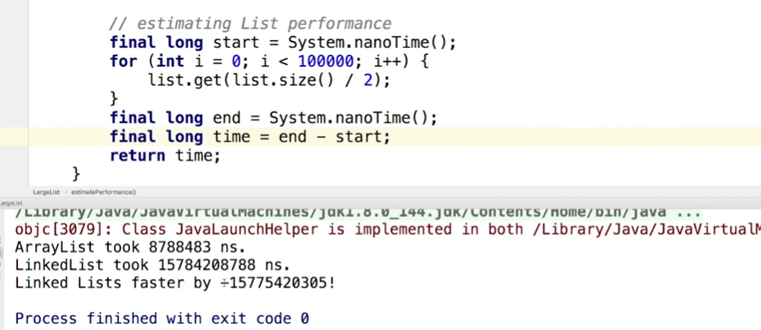
Performance Measurement
Do you have any guesses that which of the two lists will perform better?
Well, check the following image for the answer:

Slide 32

Performance Measurement
As you could clearly see, the ArrayLists do much better than LinkedLists when it comes to getting an element from any arbitrary index in the list.
But this was just the first comparison, let’s experiment at least one more operation to get a clearer picture.
Array
List

Slide 33
Performance Measurement
Let’s continue our experiment of comparing the performance of ArrayList and LinkedList with respect to add operation now. First, let’s revise:
add(Object o) appends the specified object ‘o’ to the end of any list.
add(int index, Object o) inserts the specified object at the specified position in the list.

Slide 34
Performance Measurement
Let’s modify our estimatePerformance function once again to add every new element at the starting of list instead of the last position.
private static long estimatePerformance(List<Integer> list){
final long start = System.nanoTime();
for(int i = 0; i<100000; i++){
list.add(0,1);
}
final long end = System.nanoTime();
final long time = end - start;
return time;
}
Who do you think will be faster this time??

Slide 35
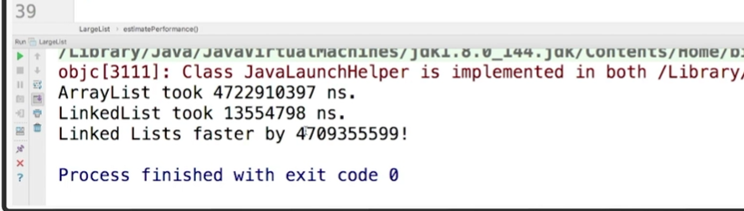
Performance Measurement
On running the code, the output obtained is shown below:
This time LinkedList seems to be much faster than the ArrayList.

Slide 36
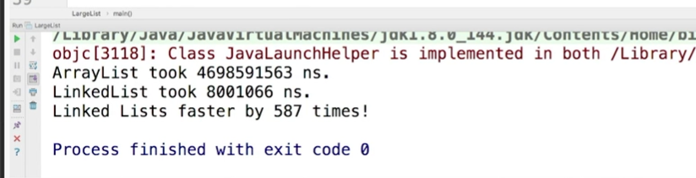
Performance Measurement
Instead of the difference between the times, let’s see how many times the LinkedList is faster than the ArrayList. Let’s calculate time1/time2 instead of time1 - time2 this time. The output will be:
Infact, LinkedList performs better than ArrayList while adding a new element not only to the 1st position, but any arbitrary position.

Slide 37

Physical Representation
Now it’s time to open the black-box and look at the physical representation of how different operations are performed in ArrayList and LinkedList
This indeed will help us get a deeper understanding of their performances and especially the differences.

Slide 38
Physical Representation- ArrayLists
Let’s start with ArrayList. An ArrayList comprises of three main features:
Java array: Consists of elements stored at contiguous memory locations.
Size: Denotes the number of elements present in the ArrayList.
Capacity: Denotes the amount of memory reserved for storing the ArrayList.
NOTE: Since capacity is the maximum value of size, size is always less than equal to the capacity.

Slide 39
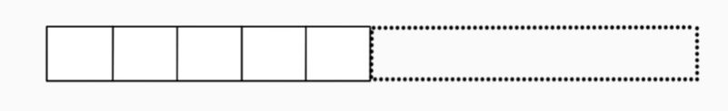
Physical Representation- ArrayLists
Let’s now actually start with the ADD operation on an ArrayList:
Consider the ArrayList given below. It has size of 5 and some additional memory is blocked for the remaining capacity as shown:
What will happen if another element is to be added now?

Slide 40
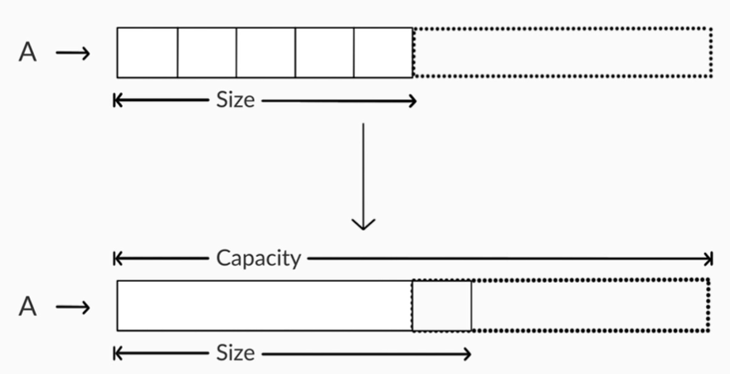
Physical Representation- ArrayLists
When an element is added, it simply gets inserted as the last element of our ArrayList, say A. The size is increased by 1 and the capacity remains same. See the image below for better understanding:

Slide 41
Physical Representation- ArrayLists
BUTTT, life is not so simple as it seems. The addition of new elements doesn’t always take place as we saw.
Before we get into more details, let’s learn a new term, Load Factor which is the ratio of size and capacity of an ArrayList.
When this ratio reaches a threshold 𝝉, the ArrayList realizes that it needs to increase its capacity to accomodate more incoming elements.

Slide 42
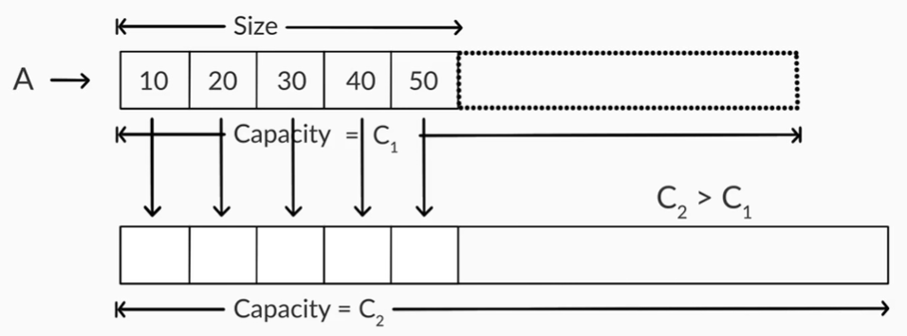
Physical Representation- ArrayLists
So, the first step in response is to allocate a memory of bigger capacity than the present ArrayList.
Then, all the elements from original list are copied one by one to the new list. Check the image below for reference:

Slide 43
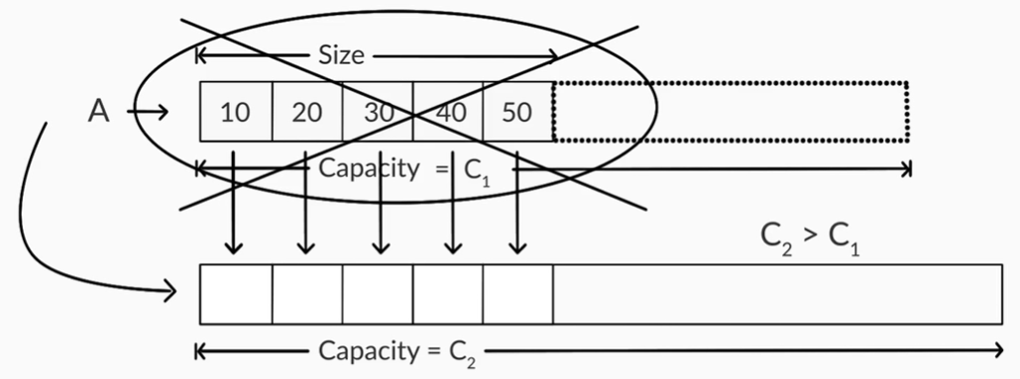
Physical Representation- ArrayLists
The final step is to change the reference of original ArrayList A to the new memory chunk. After doing so the original memory of A is discarded as shown:

Slide 44
Physical Representation- ArrayLists
Thus, the addition of an element in an ArrayList happens in either of these two directions:
1. When Load Factor(L.F) is less than 𝝉:
Most of the times, the new element is added as a new element at the end of the ArrayList.
The size of the list increases by one but the capacity remains the same
It is a fast process.

Slide 45
Physical Representation- ArrayLists
Thus, the addition of an element in an ArrayList is done either of these ways:
2. When Load Factor(L.F) is equal to or greater than 𝝉:
Although this happens rarely, but a new memory with bigger capacity is relocated to the original ArrayList. Thus, both size and capacity increase.
All the elements are copied to the new memory one by one.
This is an expensive process which takes as much time as many are the elements in the original ArrayList.

Slide 46
Physical Representation- ArrayLists
Well, this was all about inserting a new element at the last position by default.
But we also learnt that the elements can be inserted at any position of our choosing too.
So, let’s see the internal implementation of this type of addition now:

Slide 47
Physical Representation- ArrayLists
It was very simple and fast process to add an element at the last position of an ArrayList because the previous elements aren’t touched at all.
But, to insert an element in between other elements, all the elements to the right of our desired index will have to be disturbed. Let’s understand with the help of an example how does this addition proceed.
Let’s say we have to add an element 15 in a sorted ArrayList of elements- 10, 20, 30, 40, 50. The index we want to insert 15 at is 1.

Slide 48
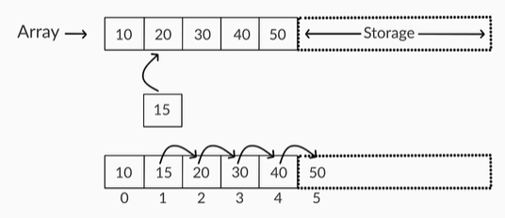
Physical Representation- ArrayLists
Here, all the elements to the right of index 1(including itself) are shifted one by one to their next index and finally the new element is inserted at 1st index as shown:
The shifting of elements begins from the last index till the 1st index.

Slide 49

Physical Representation- ArrayLists
Hence, adding new elements at positions other than the right end can be a little expensive and slow because of element shifts.
Especially, if an ArrayList has N number of elements, adding an element to the 0th index can cause N number of shifts, since the ArrayList has to shift all the existing elements to the right by 1 position.

Slide 50

Physical Representation- ArrayLists
Now that we know how the ADD operation works internally, let’s also get insights about the REMOVE function.
The REMOVE function is very similar in it’s internal logic to the ADD function with the only difference that everything is in the opposite direction to that of ADD operation.
The explanation for it is obvious because the ultimate outcomes of ADD and REMOVE are also opposite.

Slide 51

Physical Representation- ArrayLists
Just like the addition at last index, removal from last index too is very simple and fast.
We easily remove the last element of the list without disturbing any of the previous element of the ArrayList.
The size of the list after each removal decreases by 1 and the capacity remains same.

Slide 52
Physical Representation- ArrayLists
But, in most of the remove operations, the element to be removed is not the last one but from any arbitrary index.
Just like addition at arbitrary index, the removal from arbitrary index is expensive and slow too.
Let’s use the same example of ArrayList- 10, 15, 20, 30 , 40, 50 and this time we have to remove the element we added, 15.

Slide 53
Physical Representation- ArrayLists
The process of removal is exactly the same as the reverse engineering of the addition of 15 from previous slides:
The first step will be to remove 15 from index 1.
Now, we will move each element after 1st index one by one to its left index to occupy the newly generated free memory.
Needless to say, the shifting will start from the 1st index till last index( the opposiye direction of ADD operation).

Slide 54
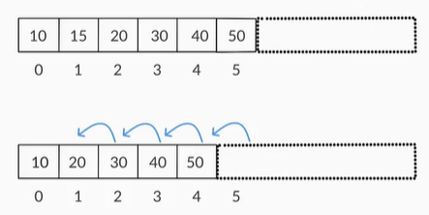
Physical Representation- ArrayLists
Let’s try to understand the same graphically:
Also, it goes without saying that the size of ArrayList decreases by one after the completion of each removal operation.

Slide 55
Physical Representation- ArrayLists
The similarities between ADDITION and REMOVAL don’t stop here.
Load Factor(L.F) comes into play here as well.
Contrary to the lower threshold in addition, L.F has an upper threshold in removal operations i.e. when the L.F falls below a threshold 𝝉, the entire ArrayList is relocated to a shorter memory chunk.
This shifting to a smaller memory also proceed in the reverse manner as that of expansion during ADDITION.

Slide 56
Physical Representation- ArrayLists
Further, the L.F thresholds during addition and removal are referred to as 𝝉₁ and 𝝉₂ respectively( 𝝉₁ >= 𝝉₂ at all times).
The proper selection of 𝝉₁ and 𝝉₂ is important as it prevents the expensive memory expansion/reduction from happening too often.
Low 𝝉₁ and 𝝉₂ waste a lot of memory as a lot of extra memory gets allotted to a list of even small size.
Similarly, high 𝝉₁ and 𝝉₂ may save on memory, but cost us performance.

Slide 57

Physical Representation- LinkedLists
We have seen that in an ArrayList, all elements are stored in contiguous memory locations. So, iteration from one element from the other is a simple task.
But in a LinkedList, the elements are NOT necessarily stored in contiguous memory locations!!!
But then how consecutive elements are linked to each other in a LinkedList???

Slide 58
Physical Representation- LinkedLists
The strcuture of a LinkedList differs a lot from that of ArrayList.
The elements of LinkedLists are stored in structures called nodes.
Each node has two parts:
The first part stores the actual value of the element.
The second part stores the refernce to the next element of the list.
Let’s see the same example we have been using. Let’s create a LinkedList of with elements/nodes 10, 20, 30, 40, 50.

Slide 59
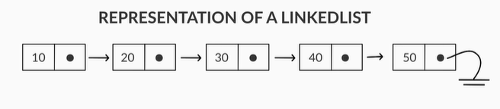
Physical Representation- LinkedLists
The graphical representation of the LinkedList thus formed is shown below:
The first node(10) is called the head node.
The last node(50) points to a null node.

Slide 60
Physical Representation- LinkedLists
The only refernce we have for a LinkedList is its head node and we cannot move to any other node without starting at the head node.
Since any random node cannot be accessed directly in a LinkedList, we can derive hint as to why the get(index) operation was so slow for a LinkedList as compared to an ArrayList.
Let’s study more about the get() function of the LinkedList:

Slide 61
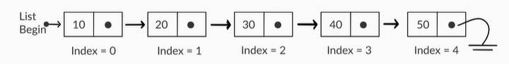
Physical Representation- LinkedLists
Let’s use the same LinkedList we used- 10, 20, 30, 40, 50 and try to run the operation get(4) on it.
As we saw already, we will start with the head node and index 0, then for every next node we increase the index by 1 till we reach the index 4 and return the value in that node.
As we can clearly see, the output will be value 50.

Slide 62

Physical Representation- LinkedLists
This long and slow proccess of getting and element from a particular index in a LinkedList is the reason why get(index) has so high speed in ArrayLists because we can directly access that element when the function is called.

Slide 63

Physical Representation- LinkedLists
Let’s now learn how the add operation is performed in a LinkedList, i.e. adding an element to an arbitrary position in a LinkedList:
To add a new node at any arbitrary index, we first create an empty node and fill the given value of element as the first part of the node.
Now, we move to the desired index and break the link between the element at desired index from its previous node.

Slide 64

Physical Representation- LinkedLists
The we make the second part of previous node(which pointed to the node at given index) point towards our newly created the node.
Further, the second part of our new node points to the node which was present at the given index.
This completes our addition operation.

Slide 65
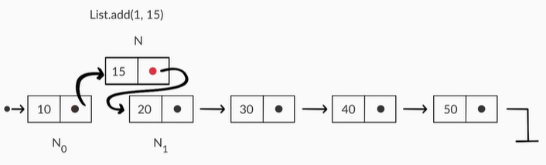
Physical Representation- LinkedLists
Let’s understand it better with the example we have been using. In the LinkedList 10, 20, 30, 40, 50; let’s perform add(1,15) operation:

Slide 66
Physical Representation- LinkedLists
Even though the addition of elements in a LinkedList seems to be more complex than that in an ArrayList, the operation is far less expensive.
This is because the operation has a fixed number of steps to carry out and only disturbs the two nodes(left and right) of the new added node.
This is in contrast to the addition in ArrayLists, where the entire list to the right of the index was disturbed.

Slide 67
Physical Representation- LinkedLists
This explains why the time taken by LinkedList to add 100000 elements was so less than the ArrayList in our experiment earlier.
Another point to be noted is that due to the asymmetric traversal nature of the LinkedList, operations in the left part or LinkedList are performed very quickly as compared to those on the right side.
And just like the ArrayLists, the removal in LinkedLists is the reverse engineering of addition as well.

Slide 68
Physical Representation- LinkedLists
Just like the ArrayLists, the removal in LinkedLists is the reverse engineering of addition as well.
It means that the previous node of the node to be removed is directly joined to its next node and this node is lost forever without any reference to it.
It can be related to removal of a faulty wagon of an otherwise functional train.

Slide 69
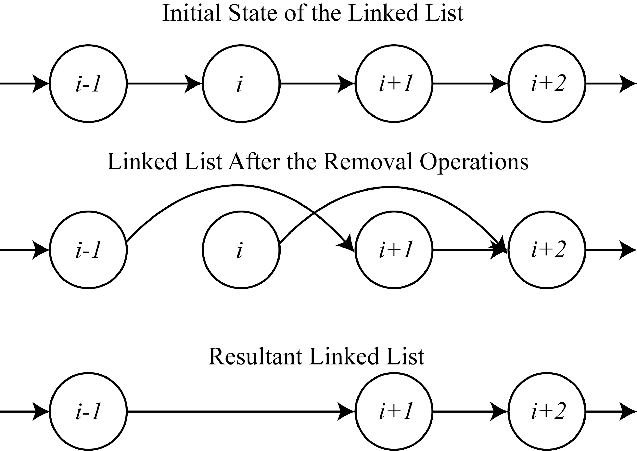
Physical Representation- LinkedLists
Let’s try to understand this operation graphically:
X
X

Slide 70
Key Takeaways
It’s time to answer the key takeaways from this lesson.
Follow the path to answer:
Module:- Arrays & LinkedLists
Session:- Performance of Lists
Segment:- Summary
OR
Follow the link:
<https://learn.upgrad.com/v/course/439/session/36949/segment/197140>

Slide 71

Thank You!
P.S. - Don’t forget the home assignment for today.
<https://learn.upgrad.com/v/course/439/session/36949/segment/197141>
Happy learning!
#LifeKoKaroLift

